Slide 1
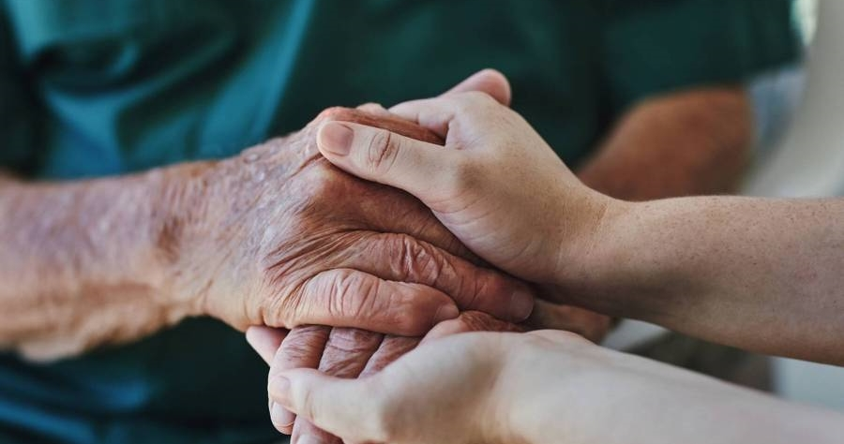
Climate Perception data collection
Alexandru-Ioan Plesoiu Robert Bruchental
Onodi Bianca Pavel Dragos Cristian

Slide 2

ABOUT THE APP
​Specialized tool, designed for collecting and analyzing mortality data in relation to meteorological conditions. It aims to provide researchers, particularly in the field of human meteorology, with detailed and reliable data on various factors such as the time, location, temperature, and associated illnesses at the time of each mortality occurrence.

Slide 3
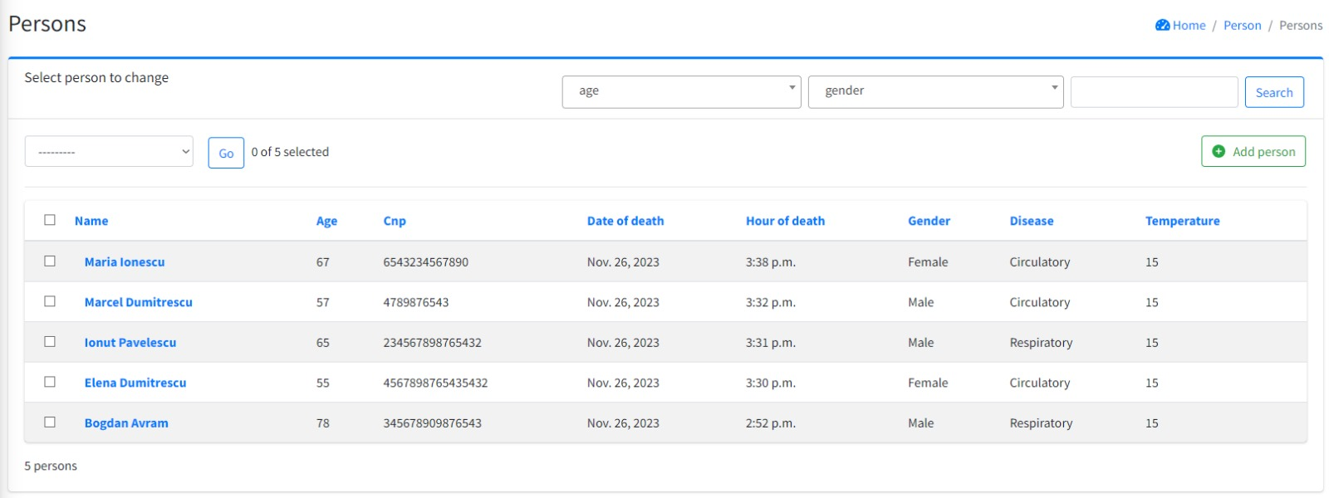

Slide 4
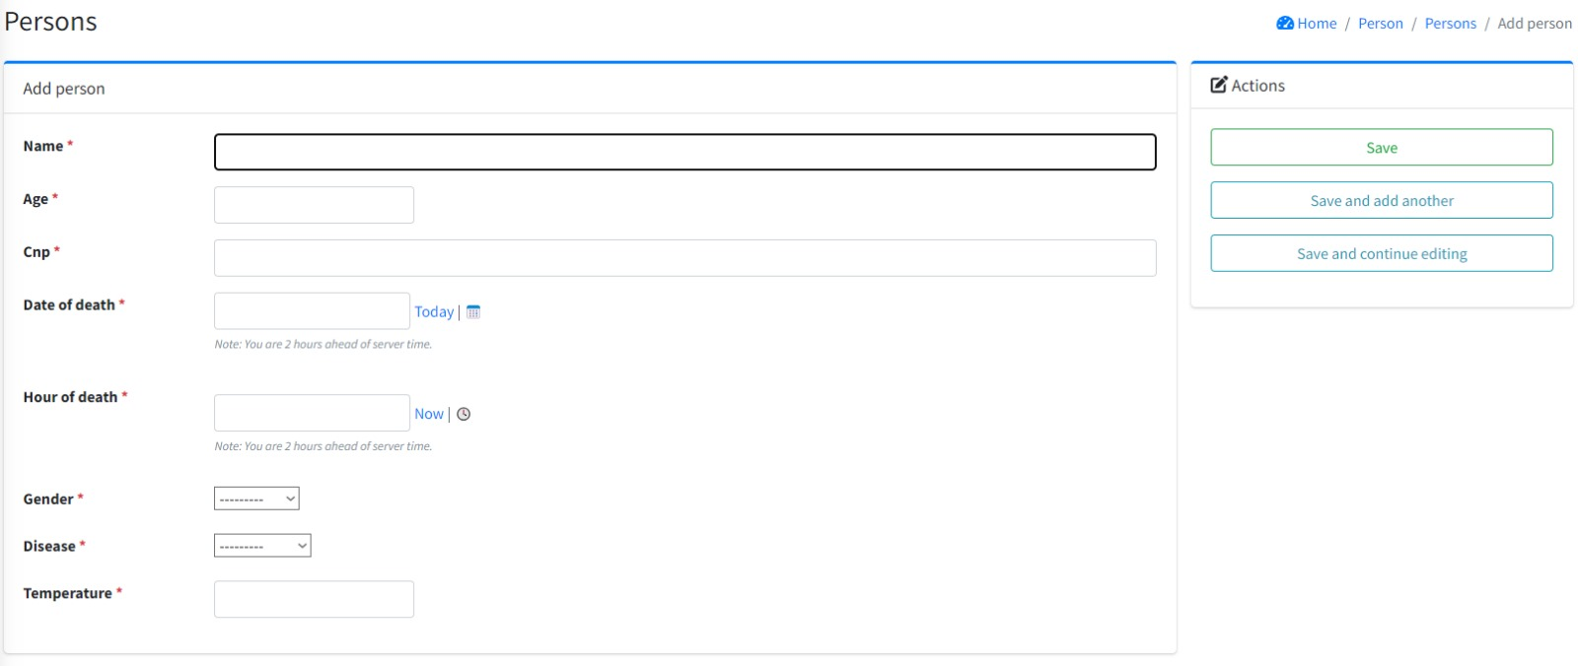

Slide 5

The app stands out for its user-friendly interface, making it accessible to a wide range of users, from academic researchers to public health policymakers. By bridging a crucial data gap in the intersection of meteorology and public health, the app plays a crucial role in advancing research, informing policy, and enhancing public health awareness regarding the health implications of climatic conditions.

Slide 6
Problem
Unmanageable data
Usability
Data unavailability
Hard to read data, collected in a messy manner
Costumers want products that are safe and most of all easy to use.
A lot of possible collectable data might come from great distance, making it hard to reach

Slide 7



Solution
Close the gap
Target Audience
Our application makes collecting data possible from all over the world, by collecting it digitally
Researchers (especially on the human meteorology domain)
Easy to use
A very plain, simple and user friendly interface

Slide 8

Product Overview
Unique
First to market
The only product with AI enforced data collecting ​
First product that’s easy to use and offers the possibility of conclusion verification ​
Authentic
AI trained with medical and mortality data from the past 10 years

Slide 9

Product benefits
Simple and efficient to use​
Easy access to data​
Research adaptable

Slide 10
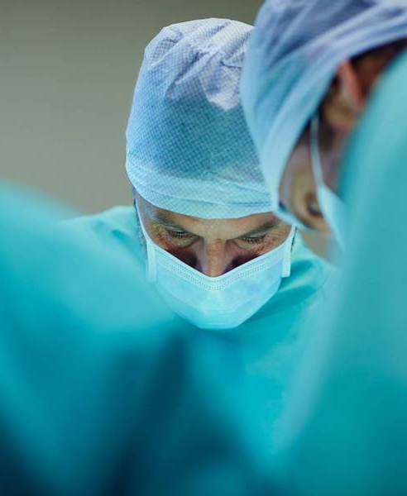
Our competition
Our app​
Competitors​
Our product is free, contrary to most data collecting softwares​
Quick and easy to use, compared to the complex systems of our competitors
Affordability and simplicity is the main draw for researchers to our app
ResearchDataGov
Product is more expensive​
HealthWeather​
Product is expensive and inconvenient to use​
EuroHealthData​
Product is affordable, but inconvenient to use

Slide 11
Competition
Simple to use​
A
OUR APP
Expensive
free
B
D
C
E
ComplEX INTERFACE

Slide 12
Growth Strategy
How we’ll scale in the future
Feb 20xx
May 20xx
Oct 20xx
Roll out product to morgues in the region to help establish the product​
Release the product to all morgues and monitor press and regional market trends​
Gather feedback from the staff and the healthcare community to expand availability of the product​

Slide 13
WEATHER BASED MORTALITY PREDICTION
Bruchental Robert-Ionut
Universitatea Babes-Bolyai

Slide 14
Goals

Slide 15

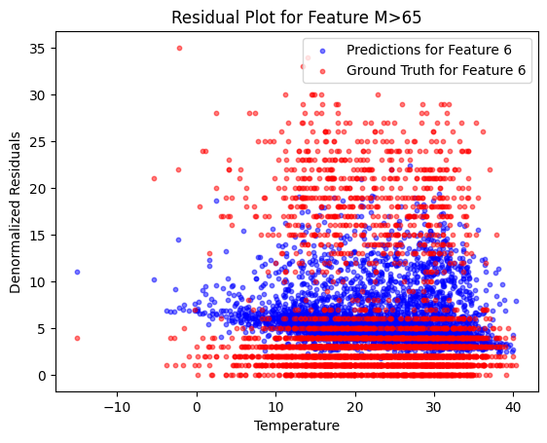
Predicting from weather data
Based on data collected from 7 cities: Brasov, Bucuresti, Cluj-Napoca, Constanta, Craiova, Timisoara
We try to predict the mortality based on gender and age category: <19, 19-65, >65

Slide 16
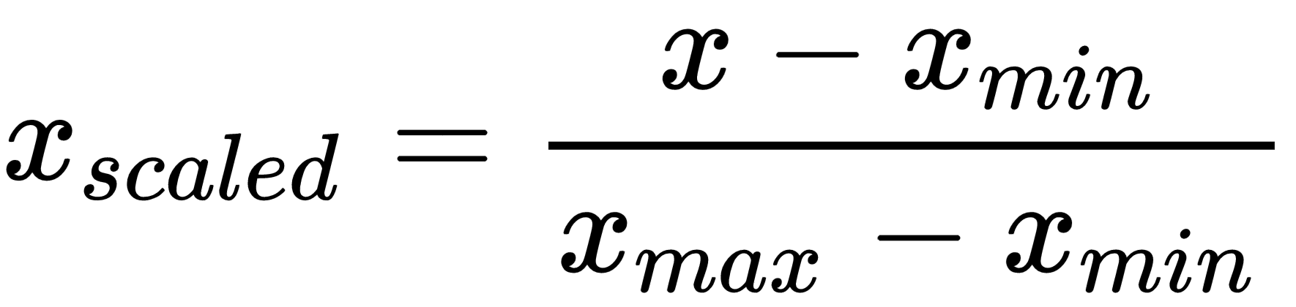
Data processing
Information was collected from 01/01/2000 to 31.12.2016
Columns with missing values were removed then the data was normalized using min-max

Slide 17
The model architecture

Slide 18
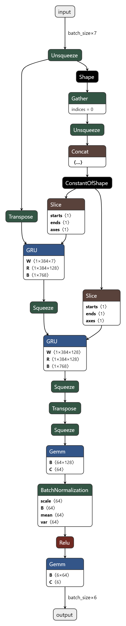
The model is a RNN
Itis implemented using the PyTorch library in Python
It consists of a Gated Recurrent Unit (GRU) layer, followed by two fully connected (FC) layers

Slide 19
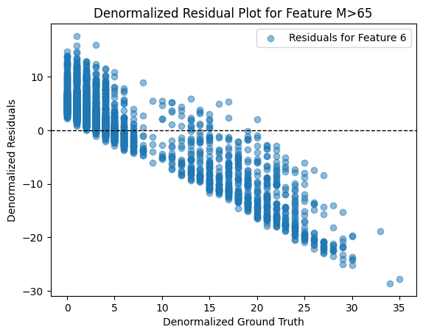
Results
On the average cases the model performs well
In the extreme cases it has a bias to predict closer to the average

Slide 20
Conclusion

Slide 21
It was possible to model a deep learning algorithm with the data provided, but further research is needed for improvement
Possibly looking for more factors other than age and gender might improve the results

Slide 22

Thank you
Pavel Dragos Cristian
Onodi Bianca
Alexandru Ioan Plesoiu
Robert Bruchental

